Slide 1
THANK YOU for supporting the 2025 Heritage Fair!

Slide 2
“The Cranbrook History Centre would like to acknowledge it resides on the homelands of the Ktunaxa People.”

Slide 3
Our Partners
School District 5
SOUTHEAST KOOTENAY

Slide 4
Our 2025 Main Sponsor

Slide 5
Our 2025 Local Award Sponsors

Slide 6
Thanks for donating items for all the participant prize bags!
ELIZABETH LAKE LODGE
JUST MUSIC

Slide 7
Participating Schools
Amy Woodland Elementary School, Stephanie Roberts, Gr.6 (2 classes) Kootenay Orchards Elementary School, Stephanie Halldorson, Gr.5/6 Kootenay Orchards Elementary, Carol Potter, Gr.5/6 Parkland Middle School, Kerri Holmes, Gr.7 Parkland Middle School, Alison Dawson, Gr.8 Steeples Elementary School, Steven Hammond, Gr.5/6 Steeples Elementary School, Jennifer De-Kieveit, Gr.6 Highlands Elementary, Carmen Bergen, Gr.5 Highlands Elementary, Karl Barg, Gr.6 Highlands Elementary, Adam Buch, The Fernie Academy, Carly Yvon, Gr.9

Slide 8
Award Winners
Stellar Achievement Awards (Provincials, July 1-4 at UBC, Vancouver)
Clara Michal, Gr.9, Fernie Academy (Ma Francophonie...)
Brett Roberts, Gr.8, Parkland Middle (Dieppe)
Oliver McCrae, Gr.6, Laurie Middle (Canadian Inventions)
National Showcase Candidates
Cassiopia Wardman, Gr.6, Steeples Elementary (Girl Guides Canada)
Maelle Fratton & Madelyn, Gr.9, Fernie Academy (Dance in Canada)

Slide 9
Local Awards from CHC (special awards; specific criteria)
COTR - Murray Chuan, Gr.6, Laurie Middle School (Chinese Immigration)
Core Heritage - Olivia McGovern, Gr.5, Highlands Elementary (History of Curling)
Legion - Rorie London, Gr.6, Laurie Middle (CWAC)
Arts - Macerena Riera, Gr.6, Kootenay Orchards Elementary (Canada's Candy History)
KEL - Teya Chretien, Gr.6, Kootenay Orchards Elementary (Residential Schools)
Regional Awards from BCHFS (special awards; specific criteria)
Human Rights - Isla Siemens, Gr.7, Parkland Middle School (L'esclavage)
Heritage BC - Cody Walters, Gr.6, Kootenay Orchards (Louis Riel Heritage)
Makerspace - Evelyn Nyquist, Gr.6, Highlands Elementary (Canadian Space Exploration)
Chinese Canadian/minority - Jake Wallace, Gr.6, Highlands Elementary (Metis Culture)
Parks Canada - Sierra Vandenberg, Gr.5, Highlands Elementary (Canadian War Brides of WWII)
Canadian Museum - Dylan Rogers, Gr.5, Highlands Elementary (D-Day)

Slide 10
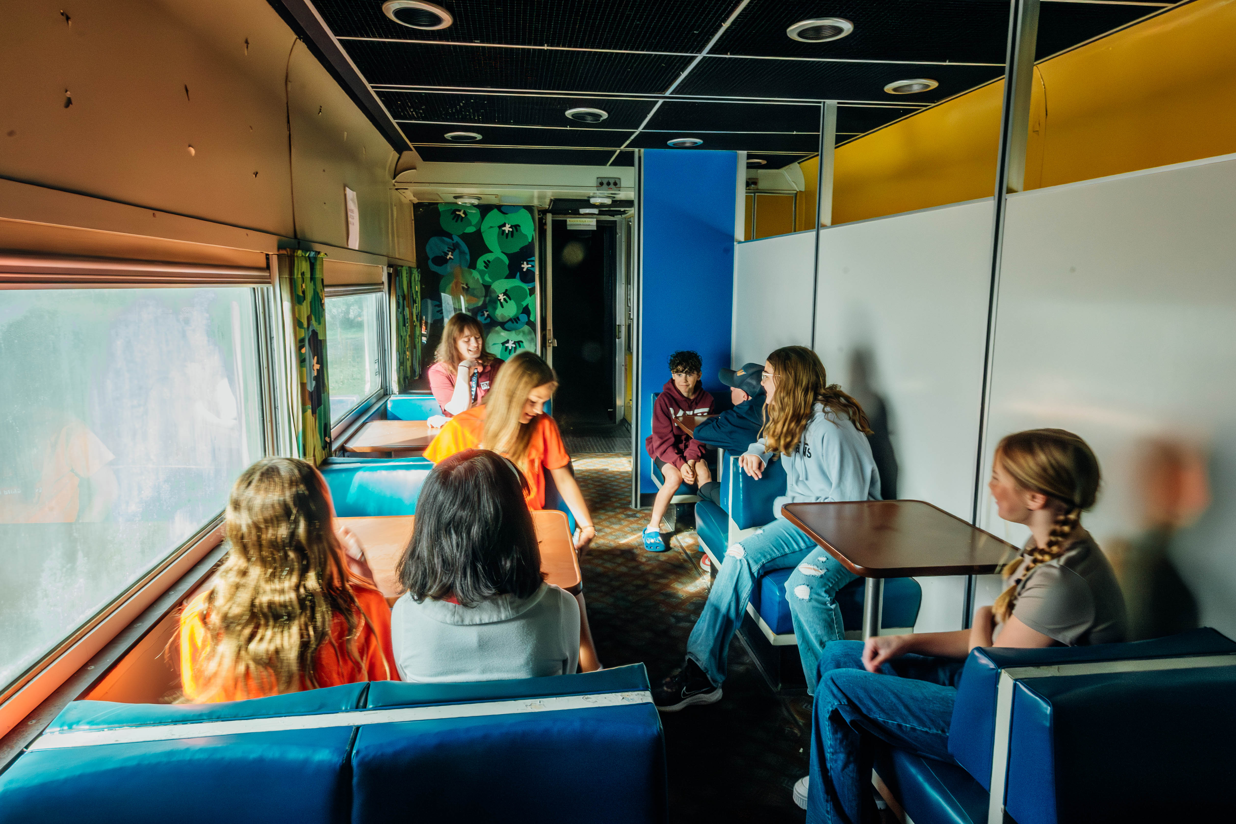
Thanks Chantal!

Slide 11
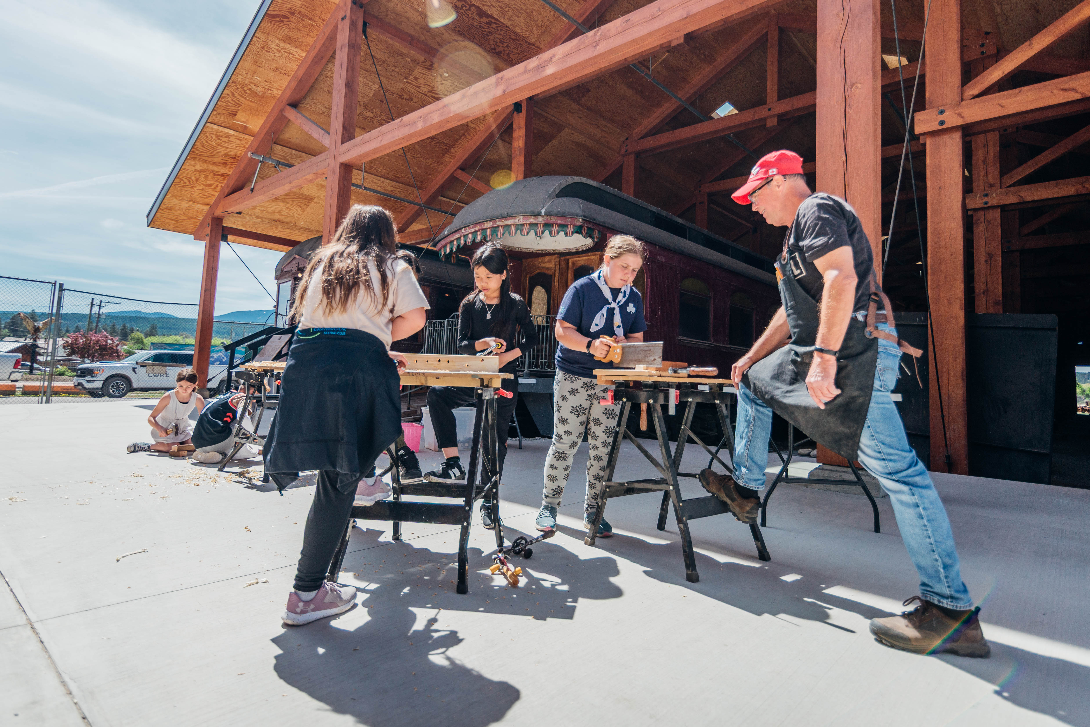
Thanks Paul!

Slide 12
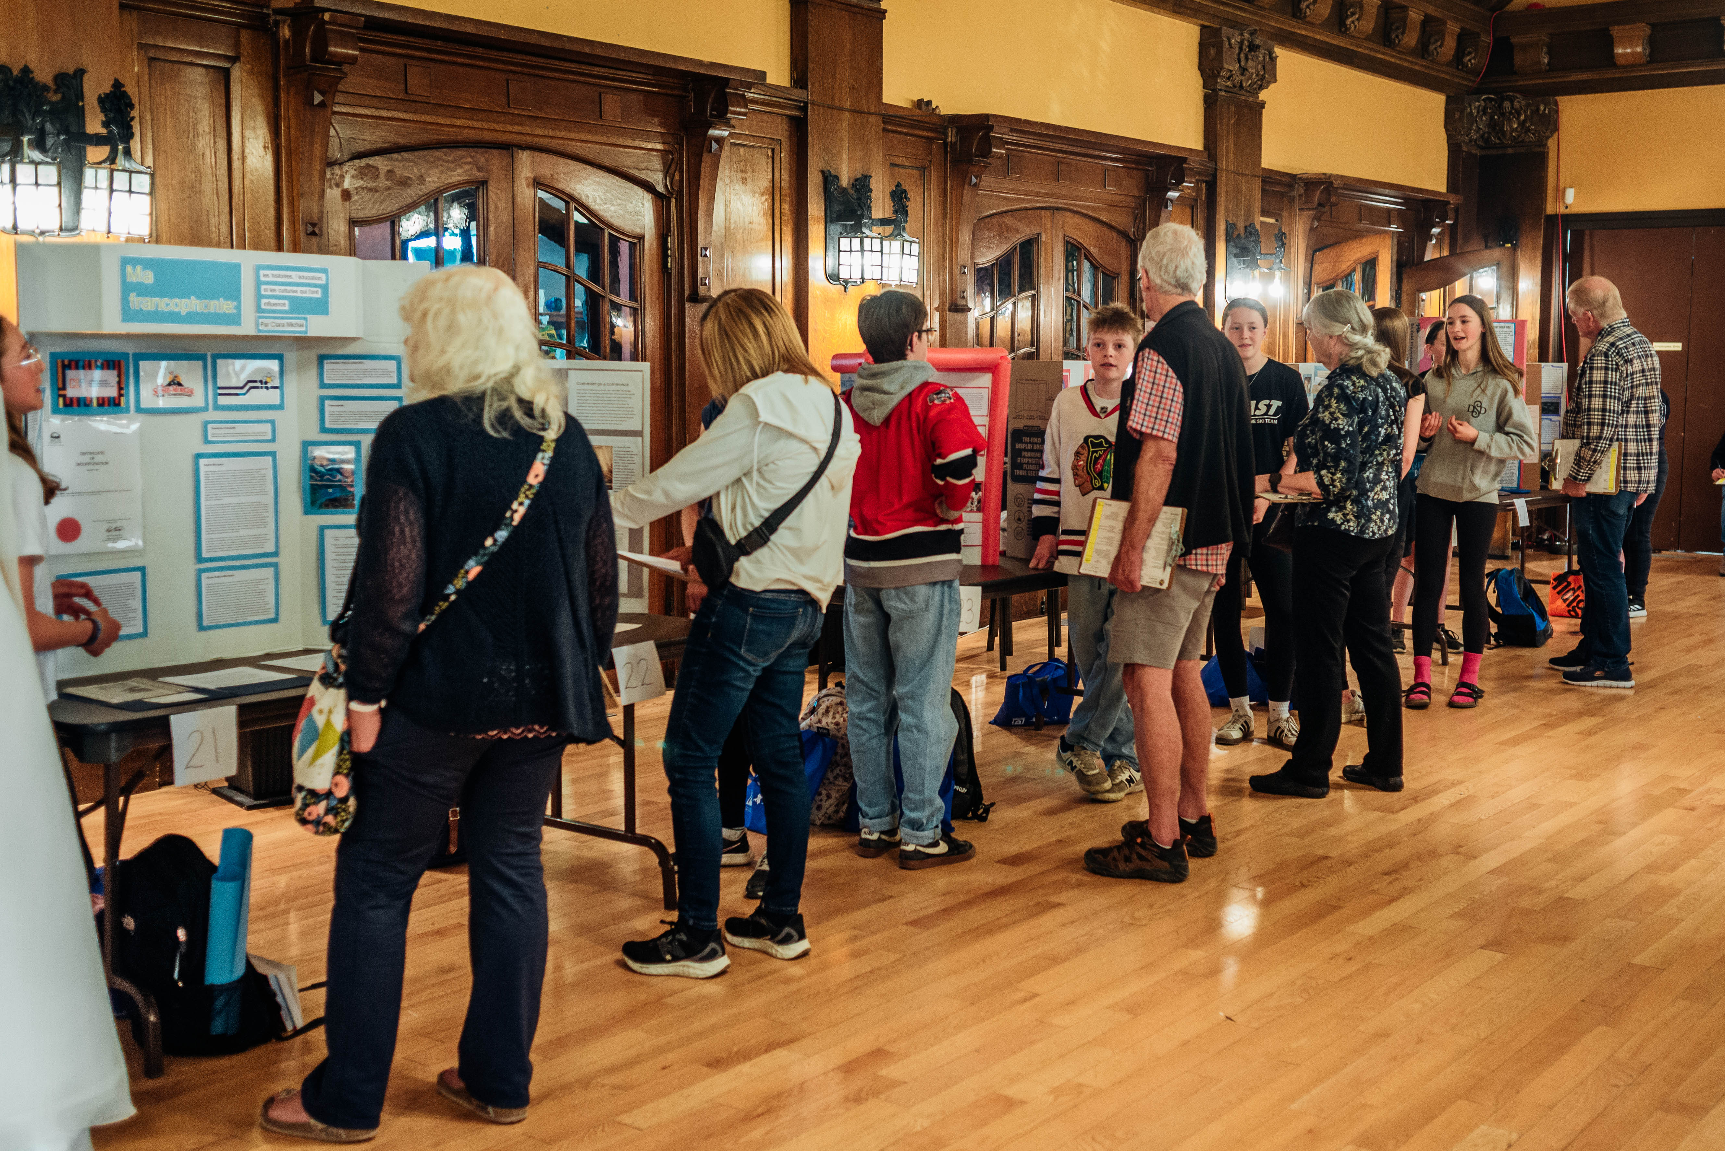
Thanks Judges!

Slide 13
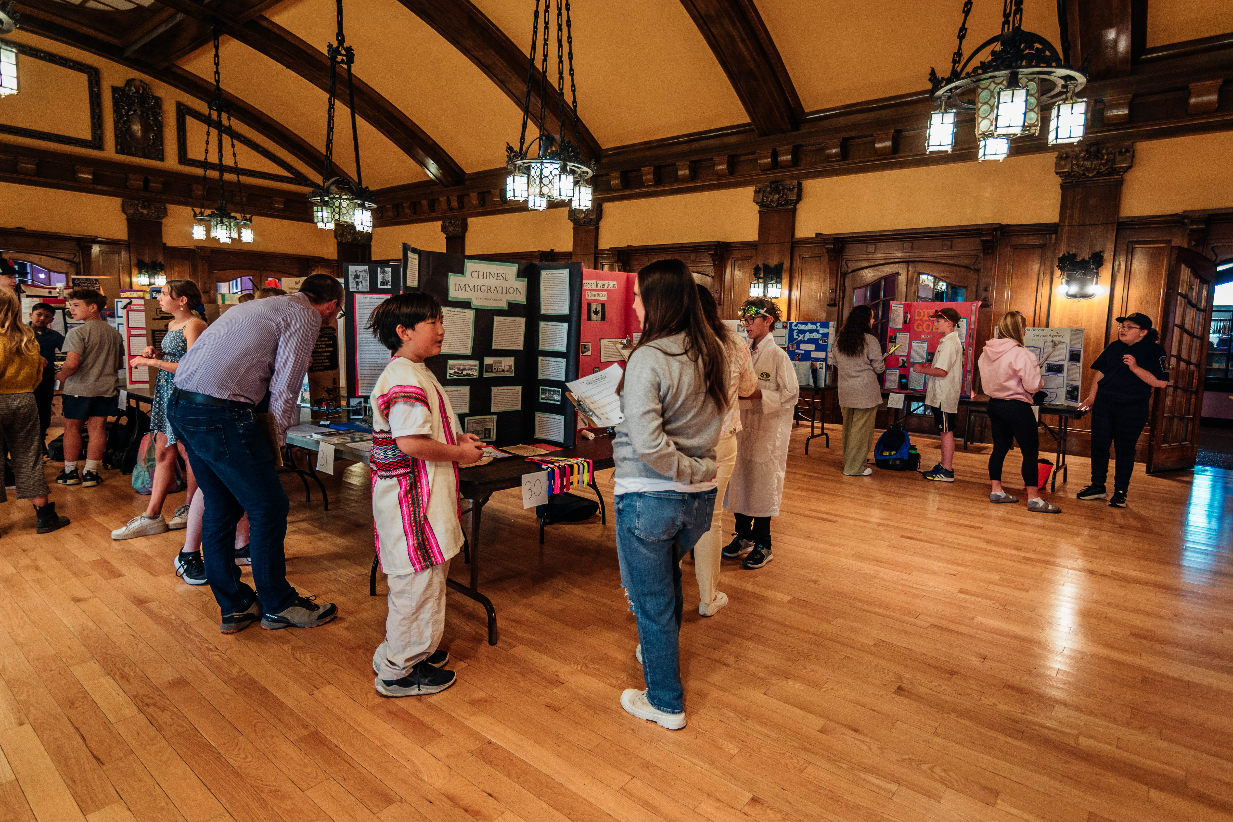
Congratulations to all participants!

Slide 14
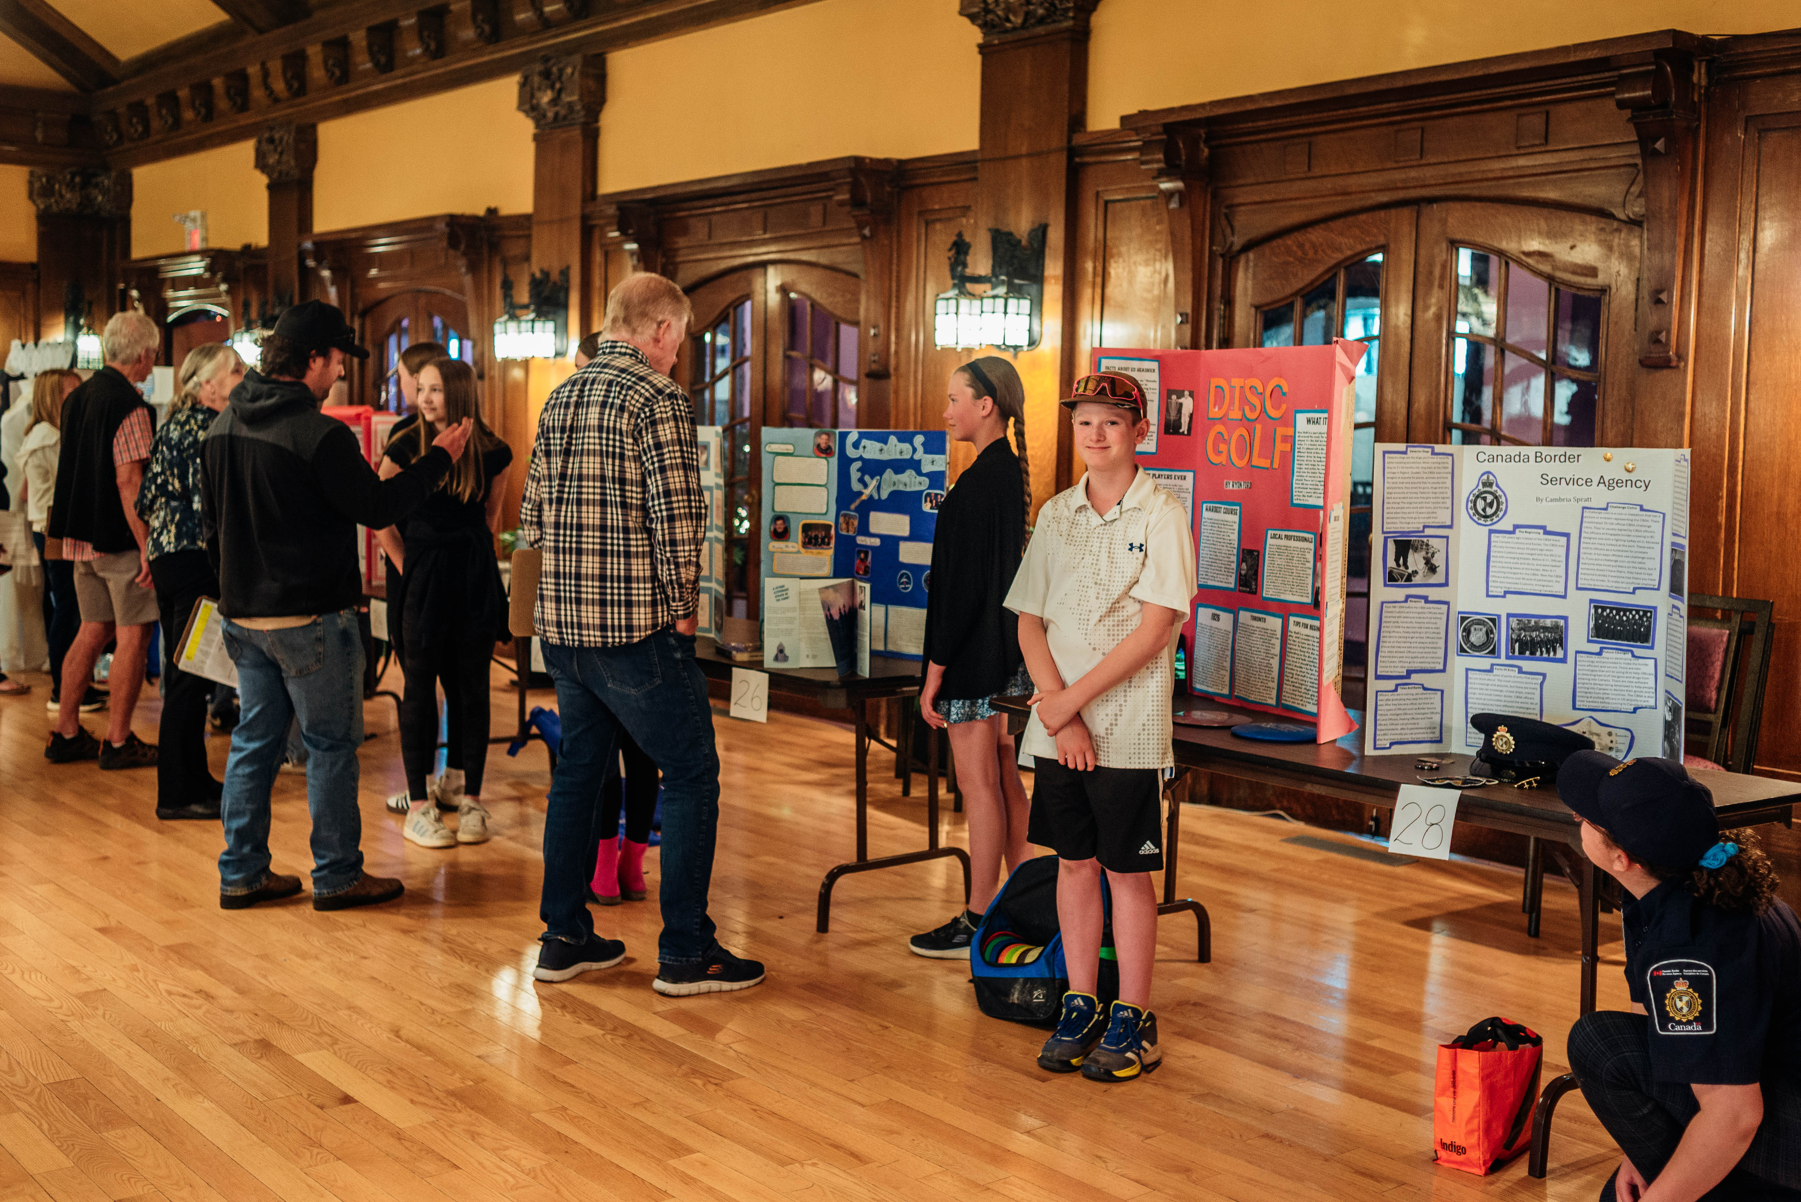

Slide 15
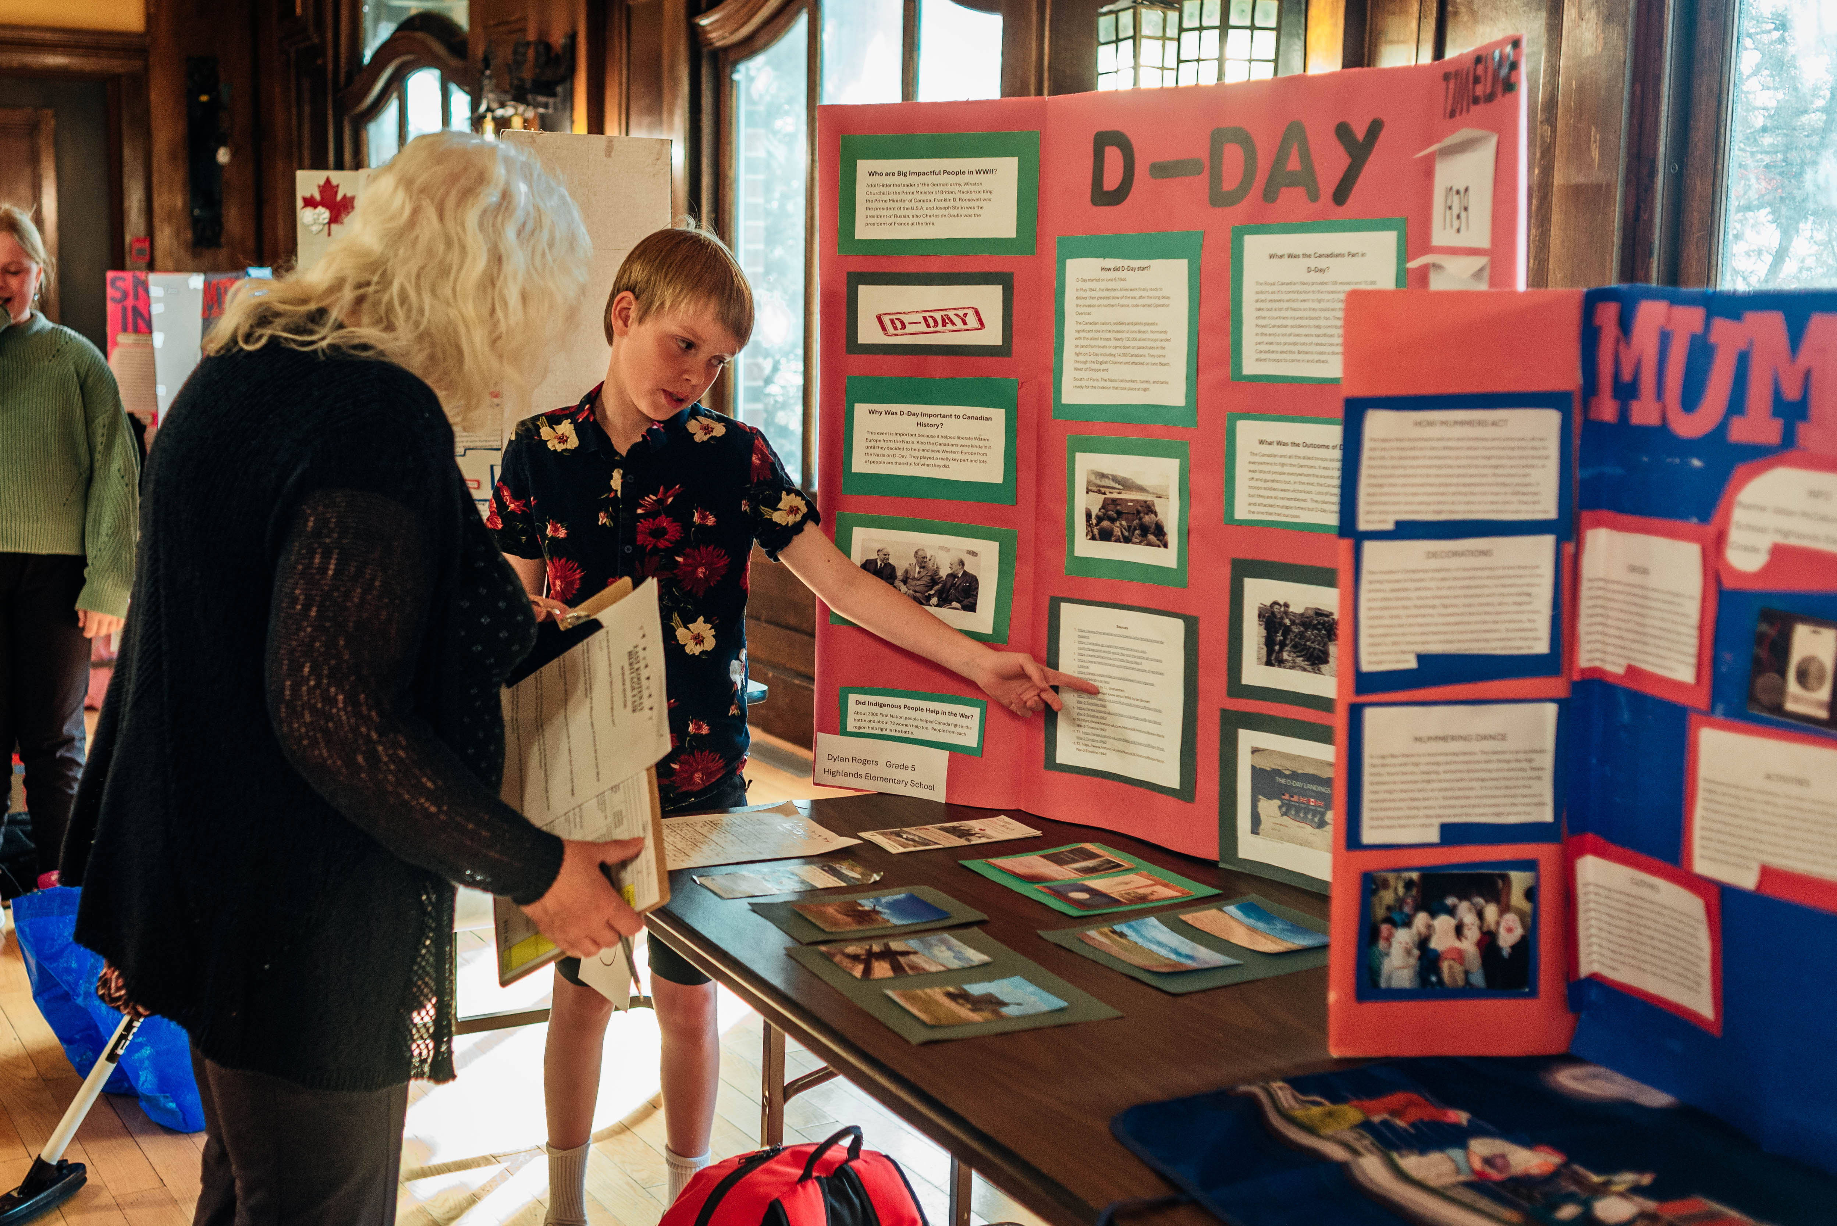

Slide 16
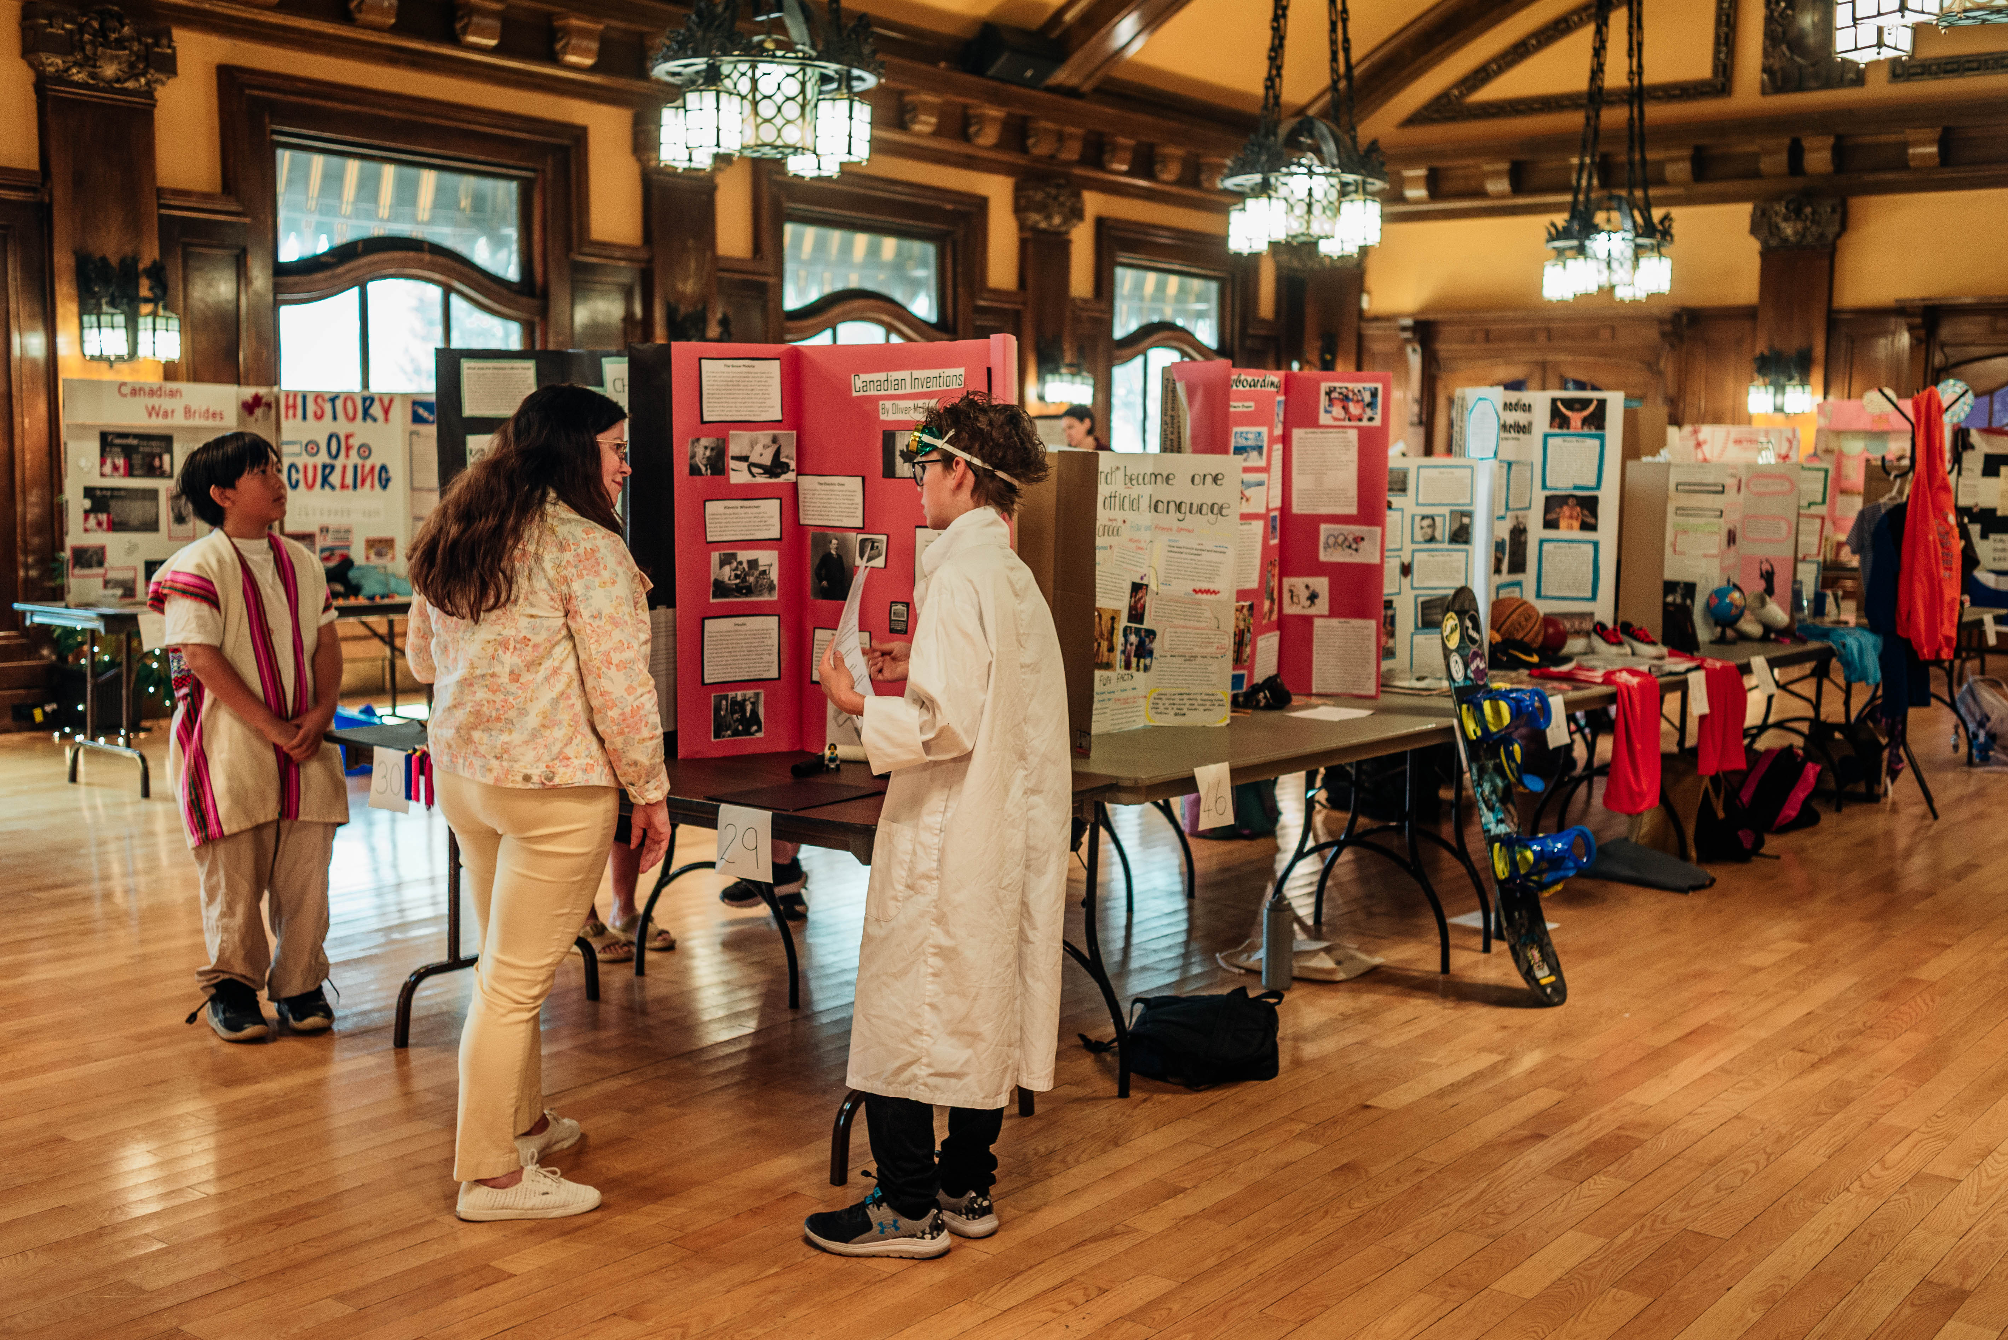

Slide 17
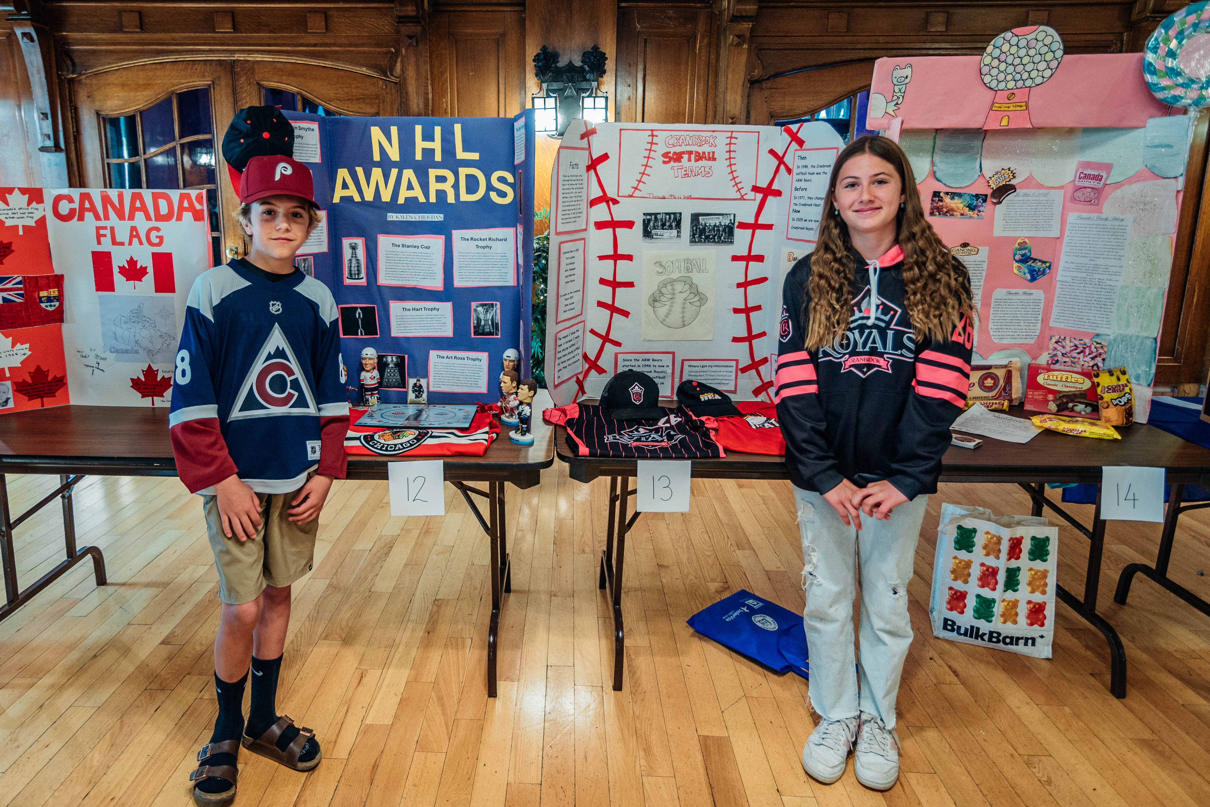

Slide 18
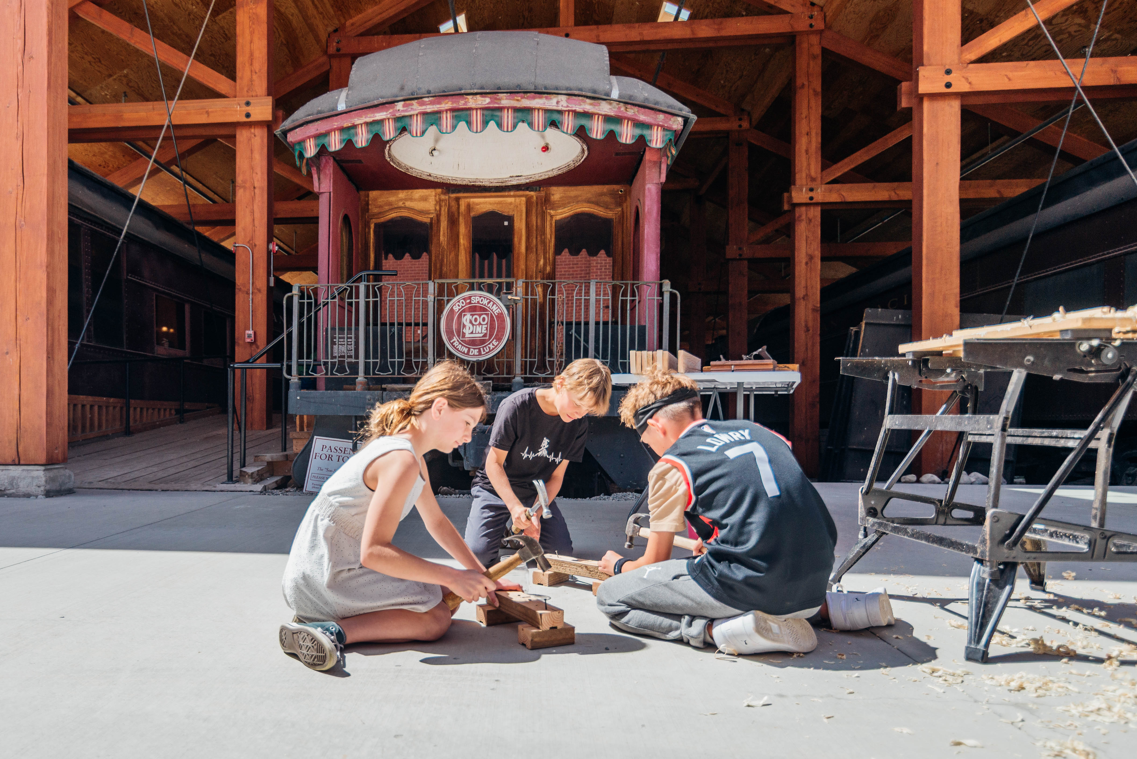

Slide 19
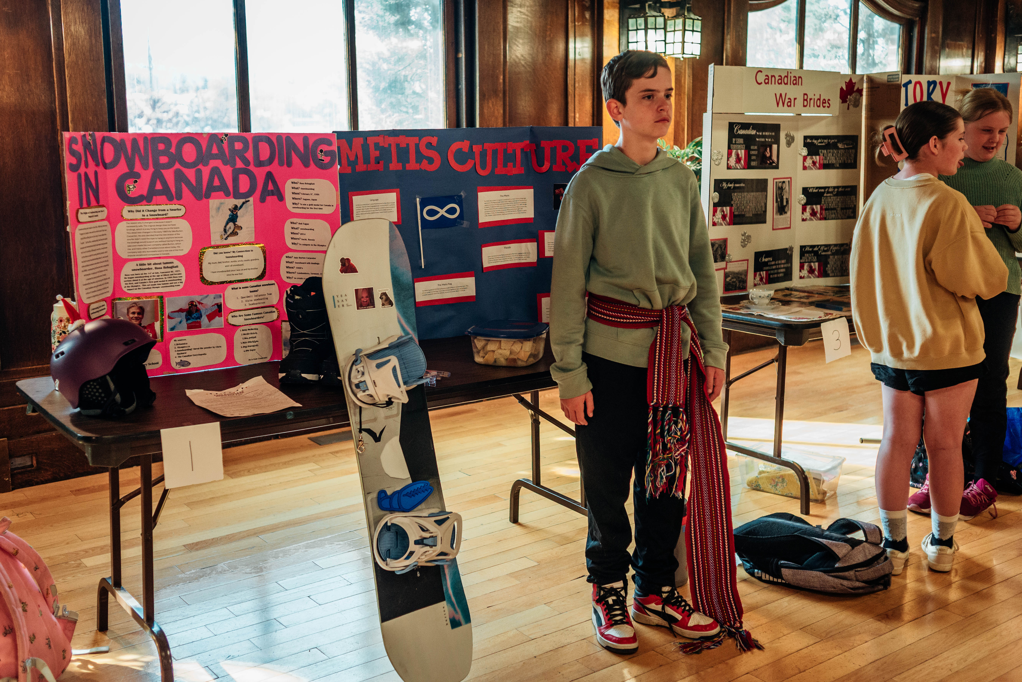

Slide 20
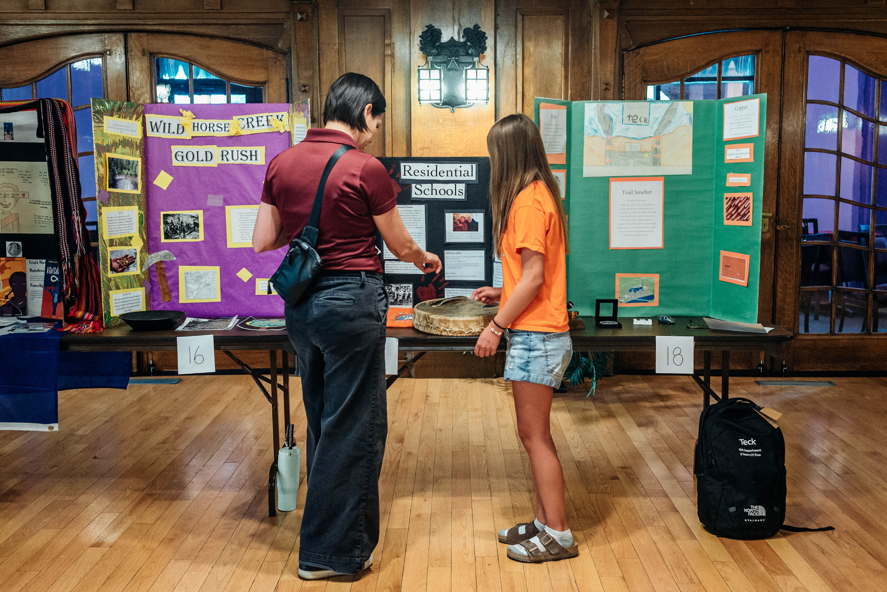

Slide 21
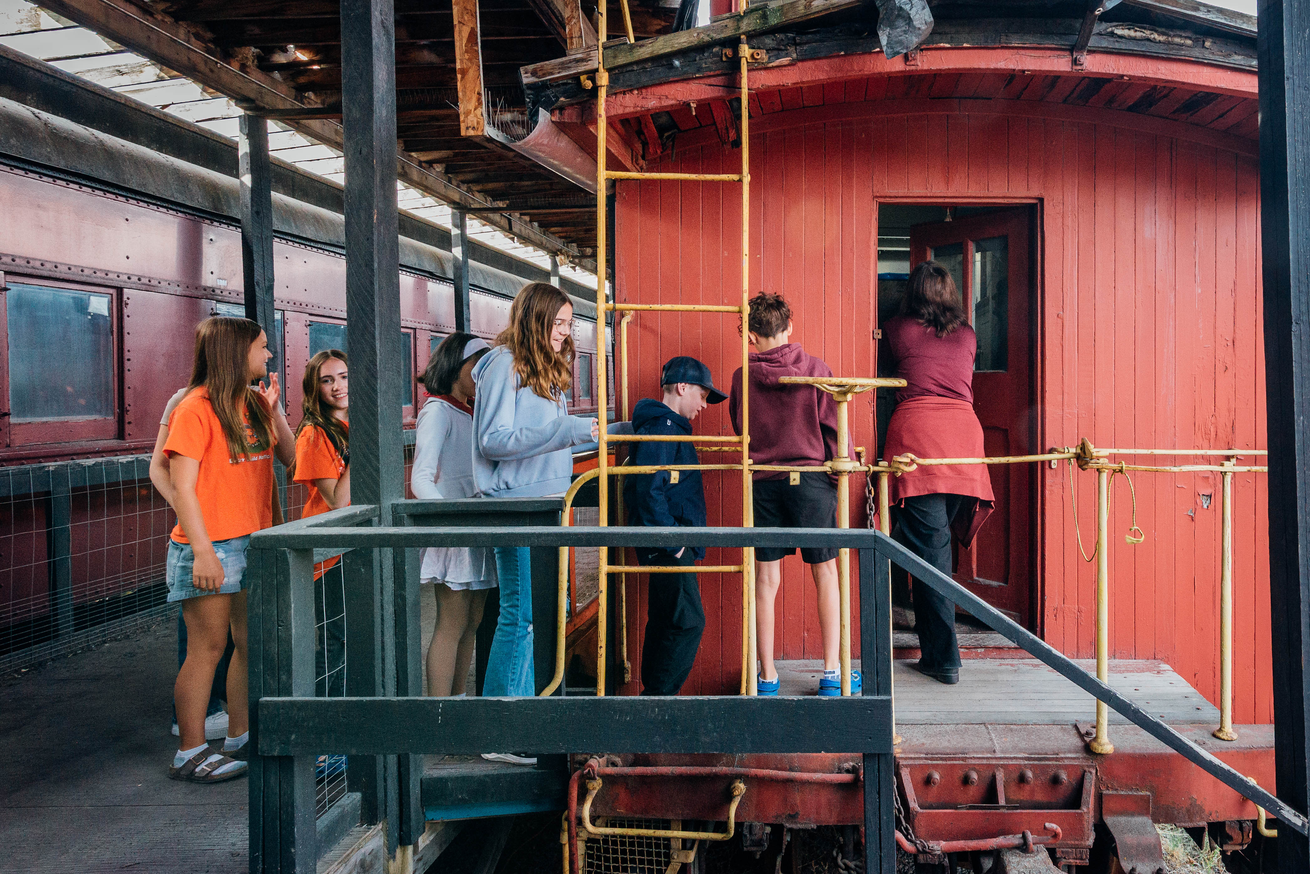
Thanks for all your support!

Slide 22
New Memberships Available!
As a member of Cranbrook Archives, Museum, and Landmark Society, you will enjoy exclusive benefits at both the Cranbrook History Centre and Fort Steele Heritage Town while directly supporting the preservation of local and national heritage for future generations.
​Membership Benefits:
Free general admission to Cranbrook History Centre and Fort Steele Heritage Town (excluding special events).
Friends and Family 10% discount.
20% discount on Tours.
10% discount at the gift shops of both Cranbrook History Centre and Fort Steele Heritage Town.
and more... Learn more at www.camal.org/members! of Cranbrook Archives, Museum, and Landmark Society,

